Slide 1


Slide 2
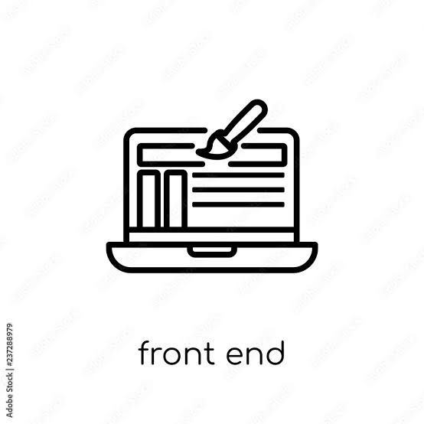
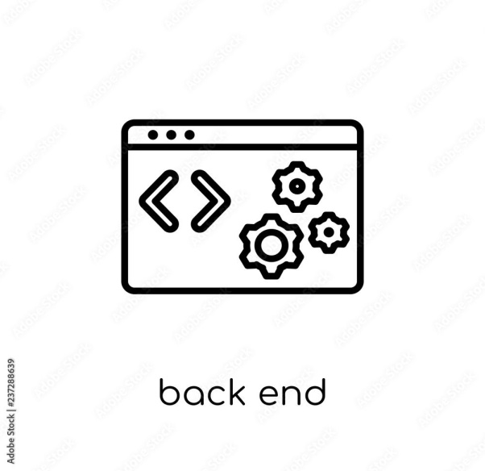
PROJECT MEMBERS
Nellore Sri Lavanya - 2487065
Pallavi A Sarapure -2487133
Pasikanti Akanksha -2484032
Pokuru Lokesh -2485815
Pooja X -2487194
Nikhil Chaurasiya - 2486837
Nikhil Ravindrabhau Botare - 2487734
Nikita Pandharinath Patole - 2487699
Nithya K J - 2487703
Panthagani Vikas Kumar - 2483838

Slide 3
ABSTRACT
ONLINE FOOD ORDER SYSTEM is a website designed primarily for use in the food delivery industry.
This system will allow hotels and restaurants to increase scope of business by reducing the labour cost involved.

Slide 4
INTRODUCTION
FoodBox is an online food delivery web application for ordering food items of different cuisines from a restaurant.
FoodBox is a restaurant chain that delivers food items of different cuisines at affordable prices.

Slide 5
TECHNOLOGY USED
Front End:
HTML,CSS3 and Bootstrap4.
TypeScript : Angular/NodeJS.
Git.
GitHub.
Back End:
Spring Boot , Hibernate , MySQL.

Slide 6
ENVIRONMENT
The system will be developed on any Windows OS machine using J2EE, Hibernate and Spring.
Intel hardware machine (PC P4-2.26 GHz, 512 MB RAM, 40 GB HDD)
Server – Apache Tomcat 8
Database – My SQL
Node Version 10
Angular CLI
JDK 1.8
Eclipse IDE or Spring Tool Suite

Slide 7
MODULES OF ONLINE FOOD DELIVERY SYSTEM
Registration Page.
Login Page.
User Login/Logout
Admin Login.
Dashboard.
Search Products.
Add Cart/View Cart.
View Previous Active Orders.
Payment Gateway Page.
Order Summary Confirmation Page.

Slide 8
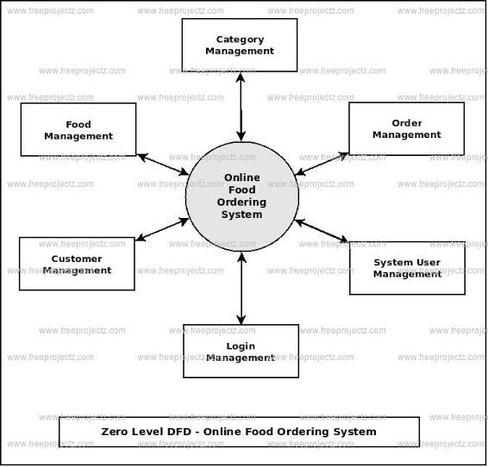
PROJECT FLOW

Slide 9
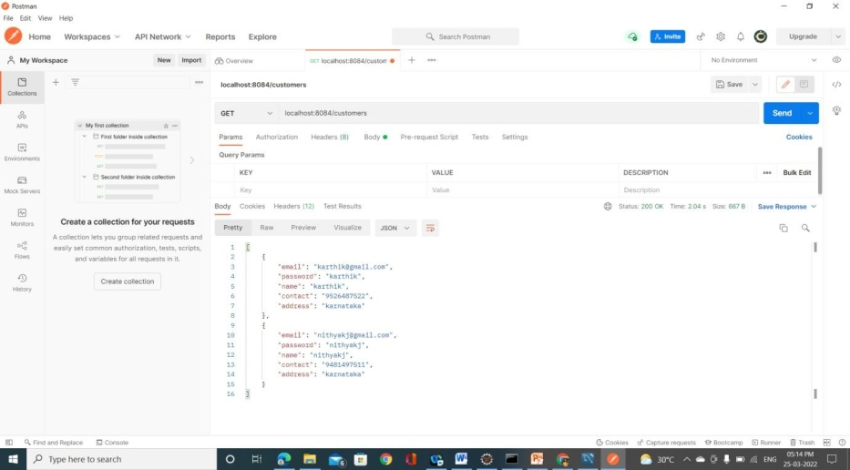
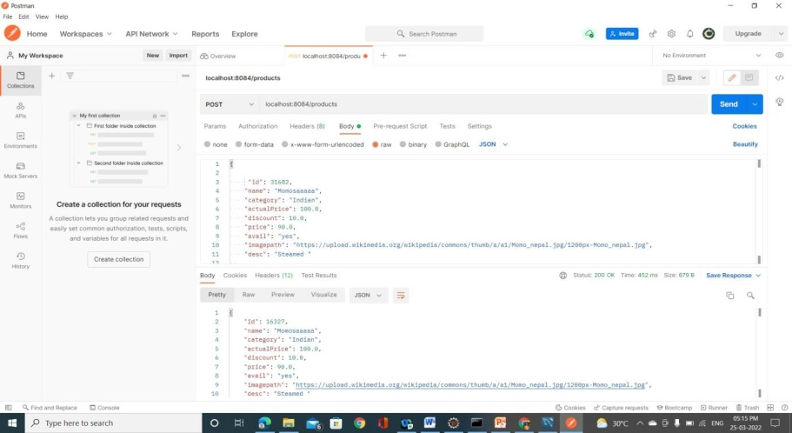
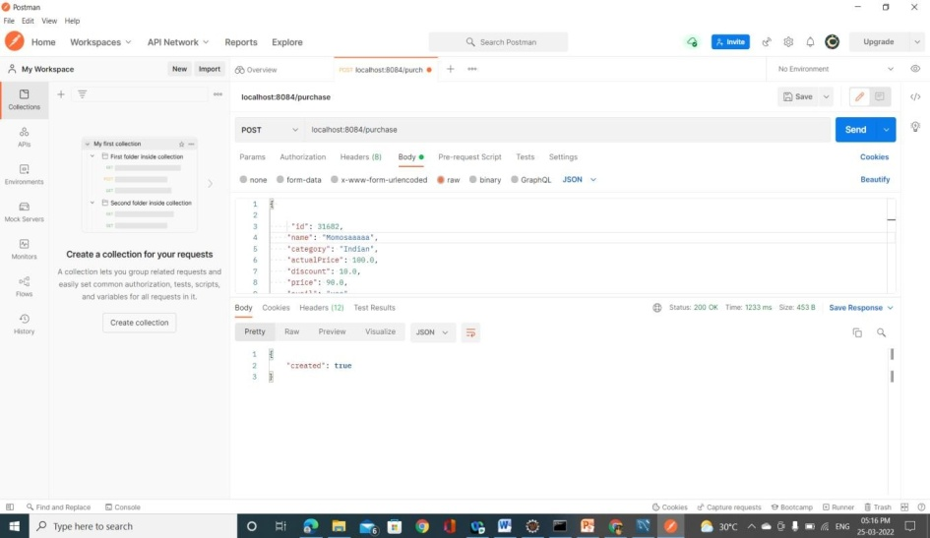
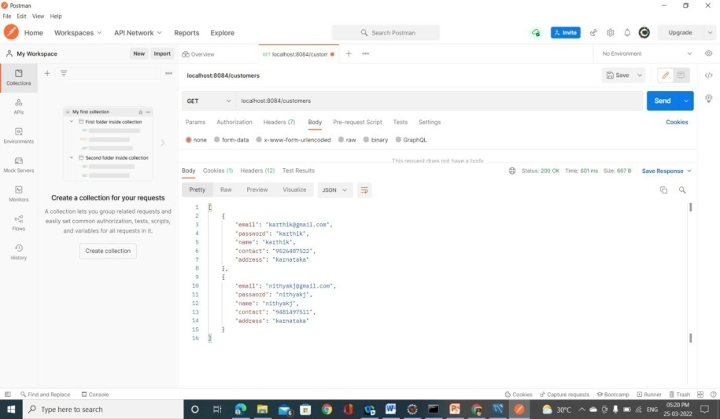
OUTPUT SCREENSHOTS
Functional Postman Testing

Slide 10
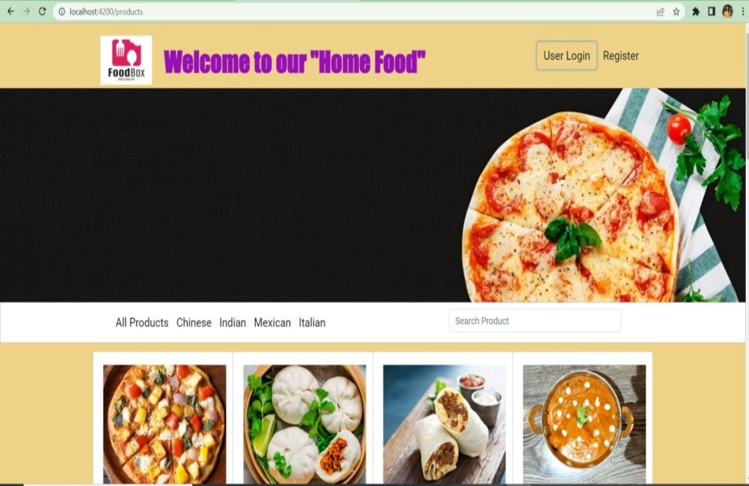
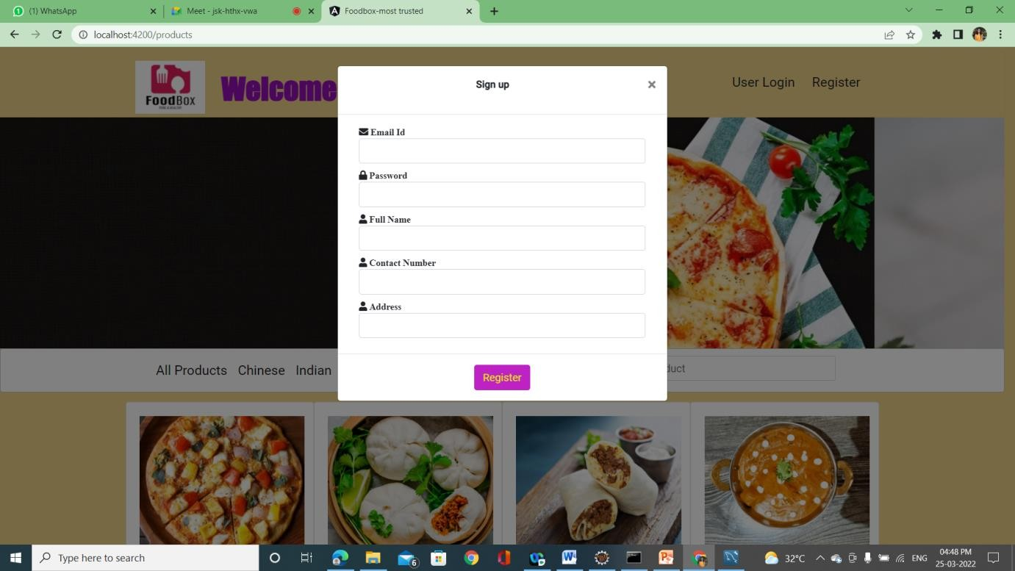
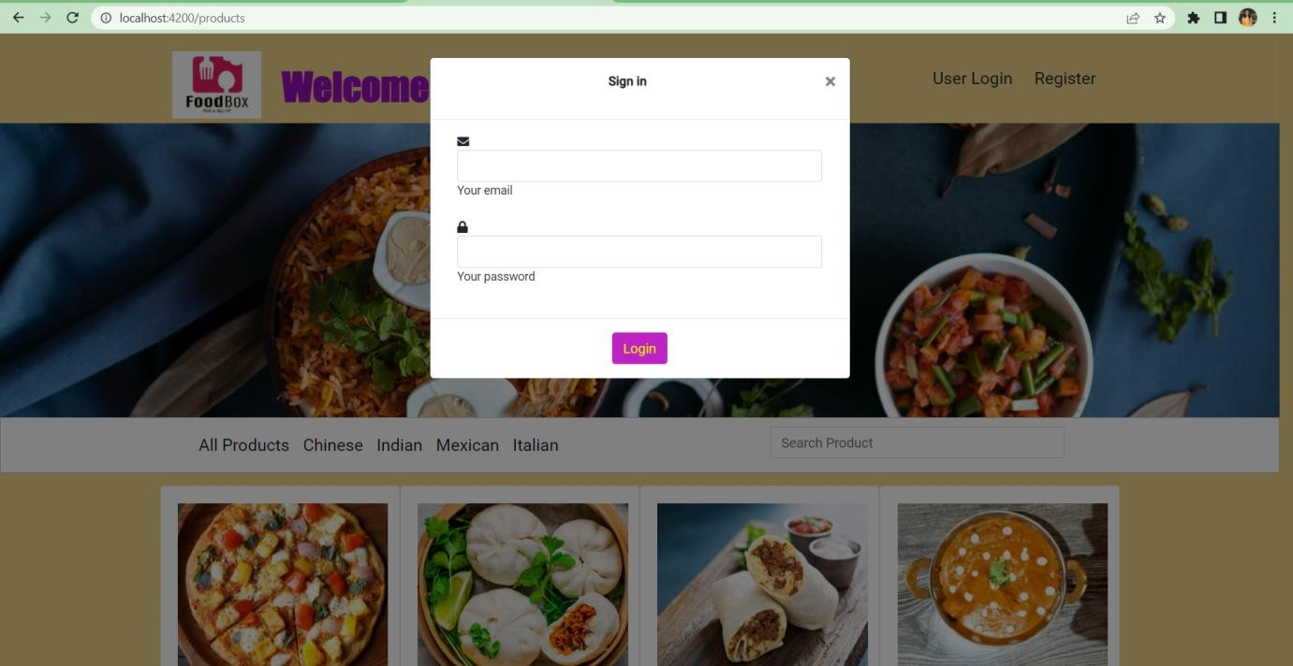
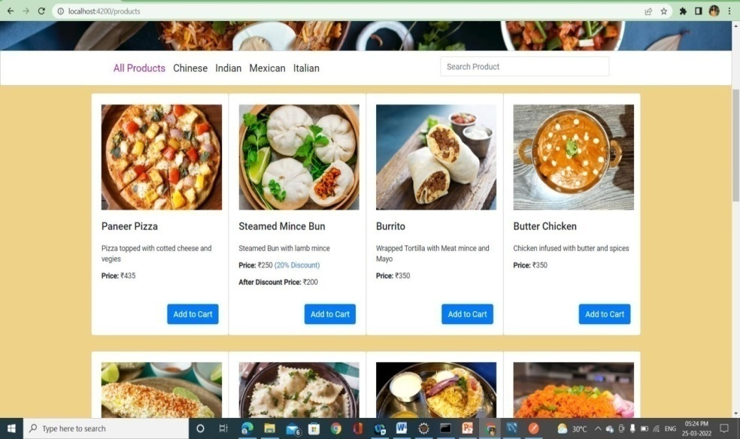
Restaurant Page
Register Page
User Page
All Products

Slide 11
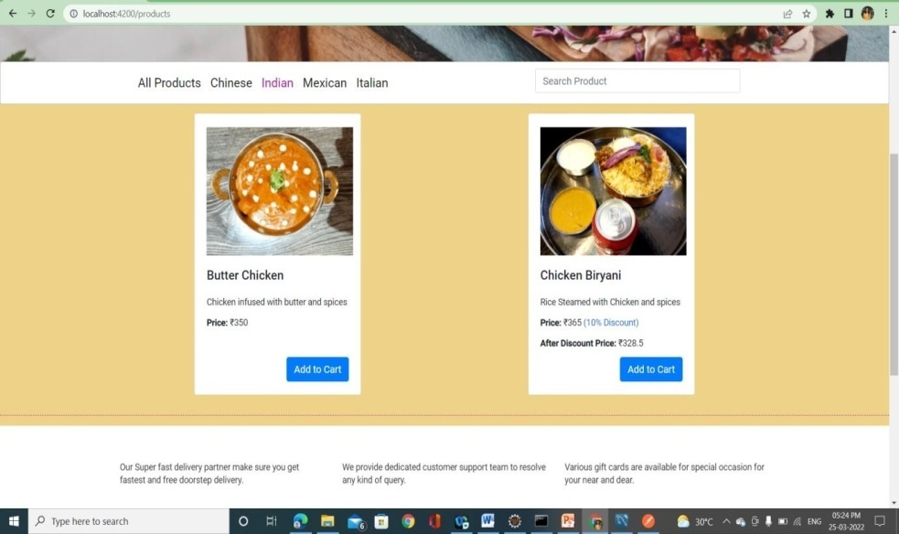
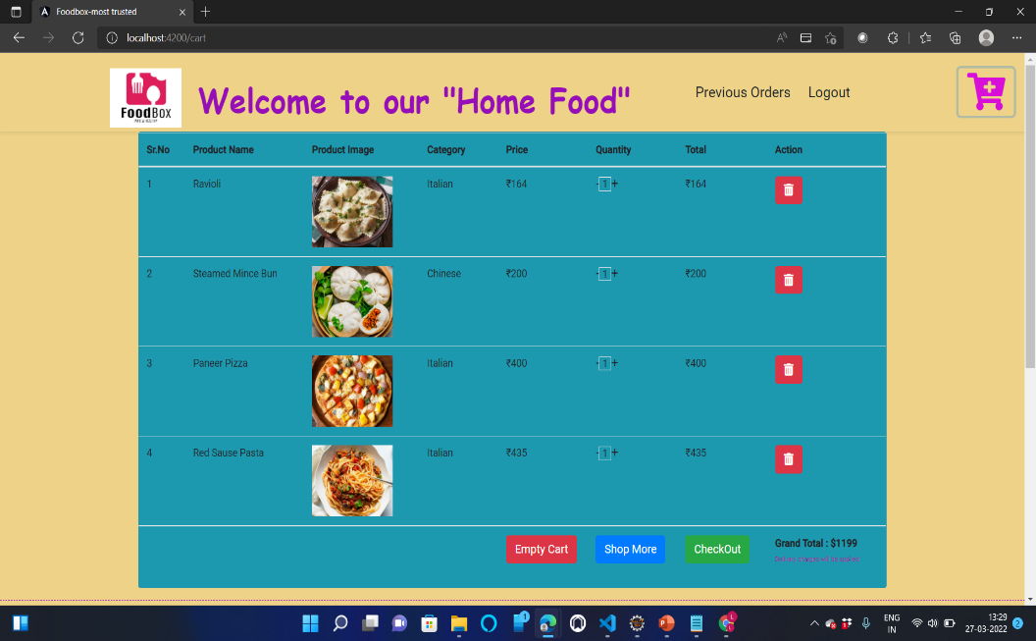
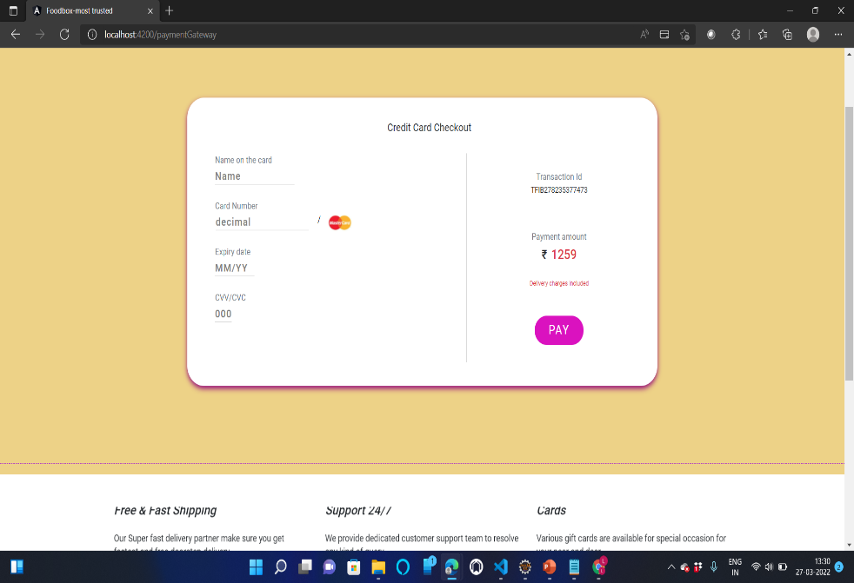
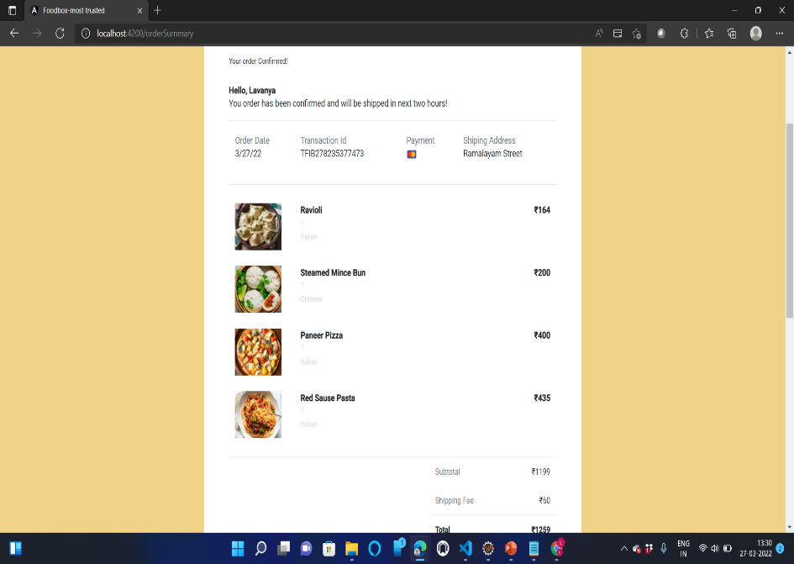
Indian Product
After adding products to cart
Card details
After payment order cofirmed

Slide 12
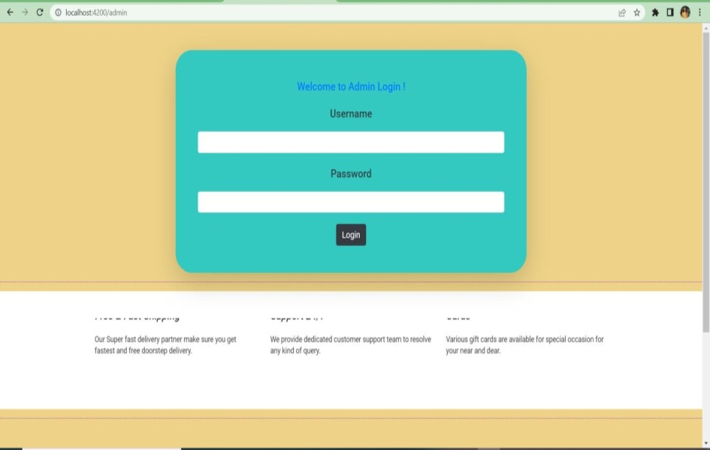
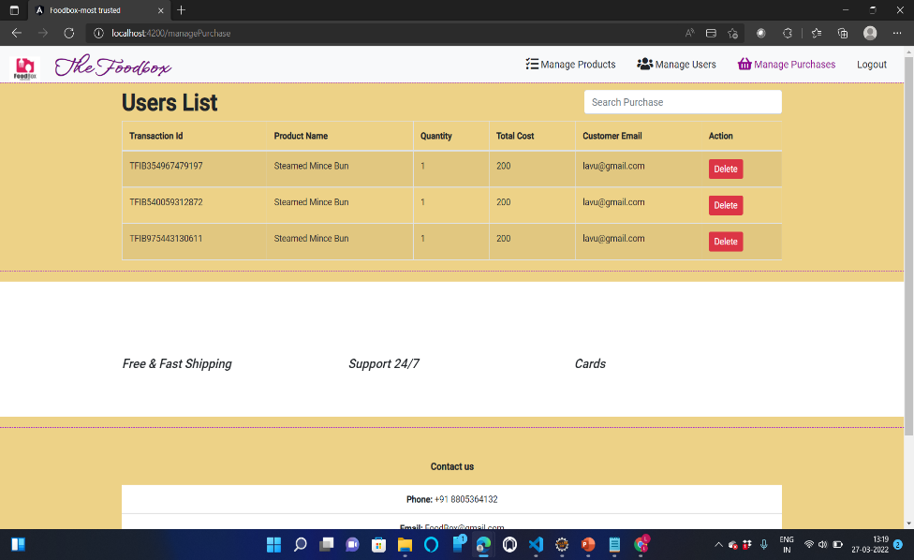

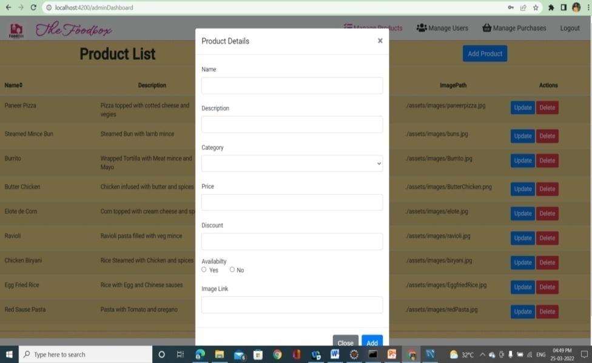
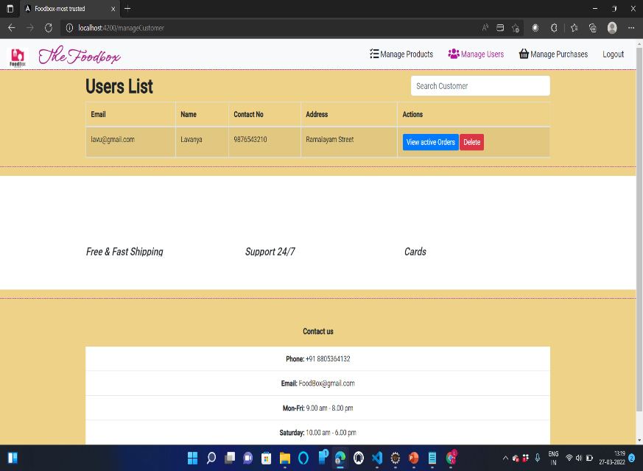
Admin Managing the customers
Admin can add a product
Admin managing the users

Slide 13
CONCLUSION
An online food ordering system is developed where the customers can make an order for the food and avoid the hassles of waiting for the order to be taken by the waiter.
Using the application, the end users register online, read the E-menu card and select the food from the e-menu card to order food online. Once the customer selects the required food item the chef will be able to see the results on the screen and start processing the food.
To provide a bug-free Online Food Delivery system to Users as well as Admin.The main objective is here to provide a nice and secure platform for Ordering Food.To maintain the records of Product, Category available into the system.

Slide 14
THANK YOU

